Slide 1
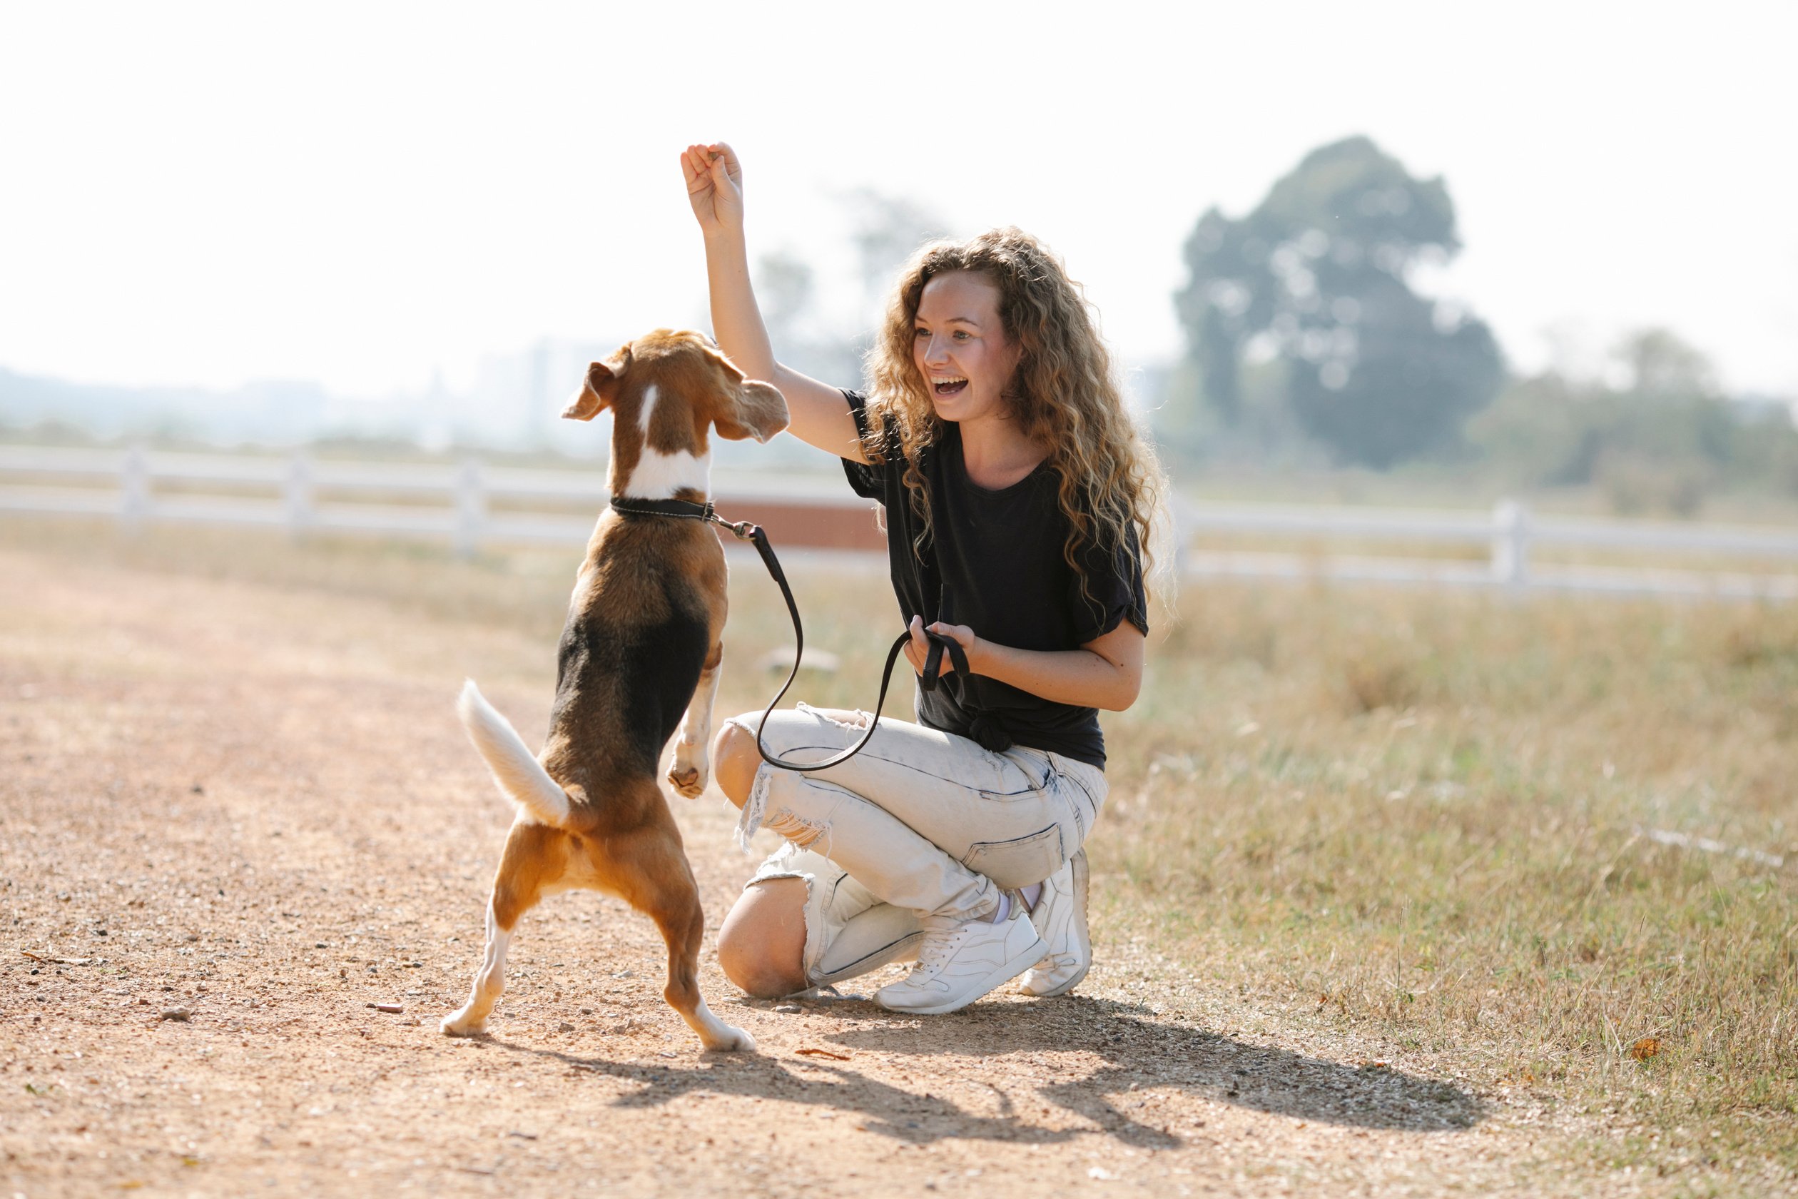
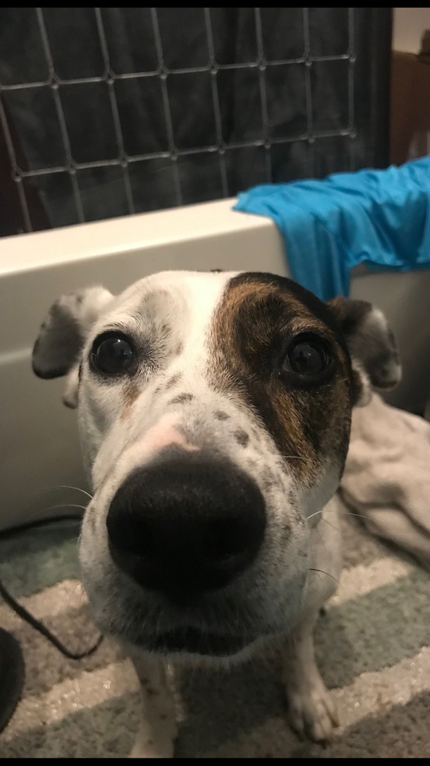
SAFE PAWS
TEAM FOXTROT

Slide 2





MEET THE TEAM
Nathan Phan
Sensors
Victor Gonzalez
Communications
Terry Jenkins
Data Systems
Clayton Lott
Power Systems
DeArirreis Vance
Software

Slide 3


PROBLEM STATEMENT
Assessing your pet’s health and well being can be a difficult task.
Surgery
Chronic illness
Old age
Too much activity
Owners are too busy to monitor.

Slide 4
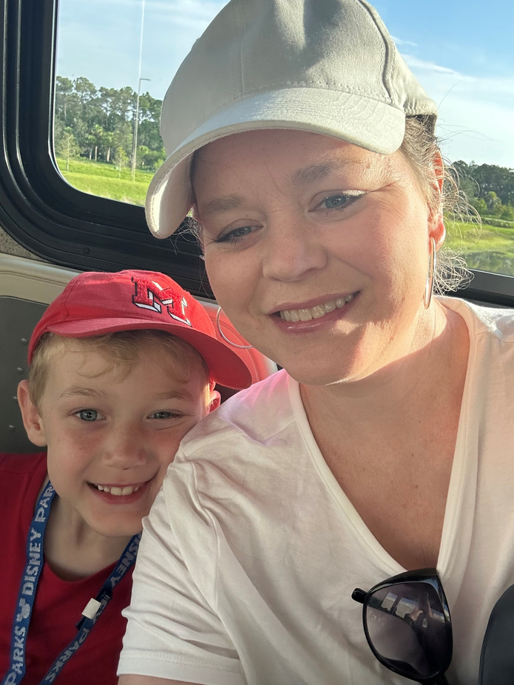
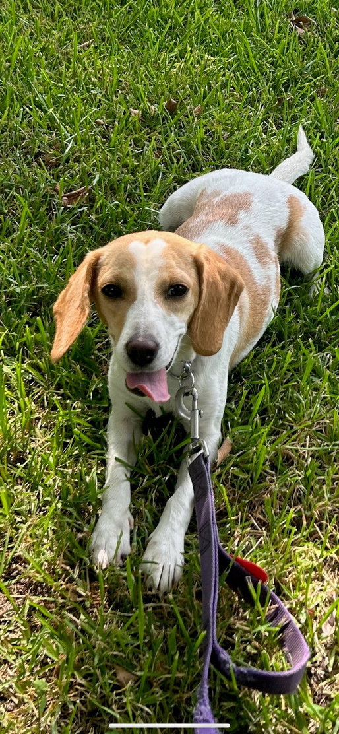
Alexis Nordin
Age : 43
Married, 2 Children
Occupation: Teacher
Sally- Beagle Mix
Age : 2
Health issues: heartworms, currently being treated
Has to stay calm and relaxed

Slide 5
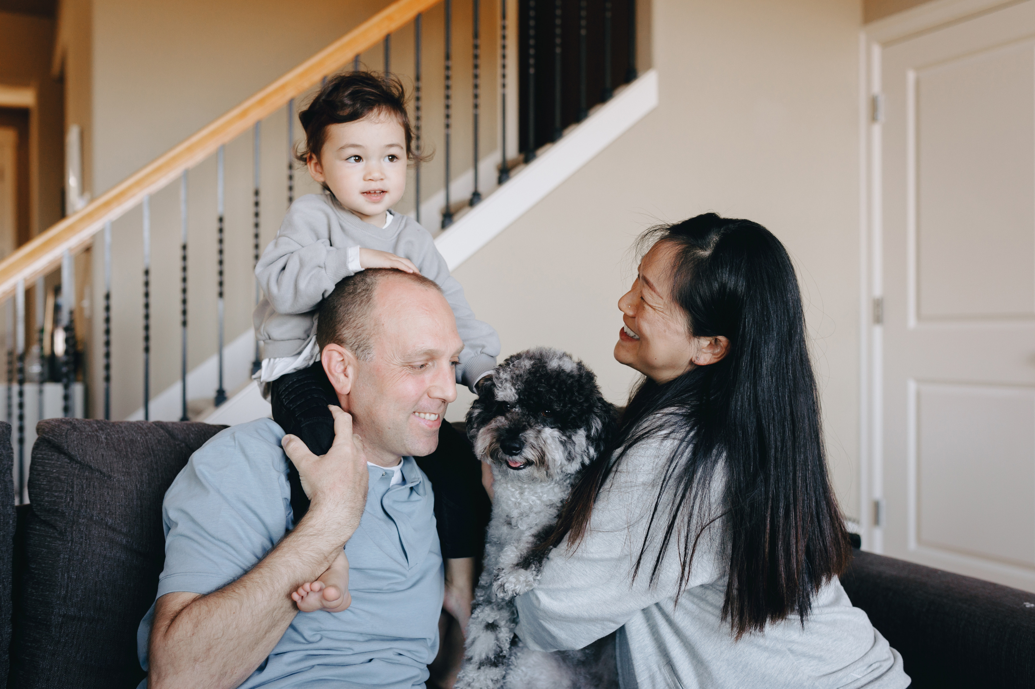




TARGET AUDIENCE
Pet Owners: Wants to ensure their pet’s well-being but struggles to juggle a busy work schedule and pet care responsibilities.
Veterinarians: Needs to remotely monitor and diagnose their patients' health conditions while also tracking progress over time.

Slide 6
SOLUTION
A smart device that allows for pet owners and caretakers to monitor their pet’s health and well-being remotely:
Monitor Vital Signs & Track Activity Levels
Receive Notifications in a User-Friendly Design
Wearable Comfort with a Long-lasting Battery

Slide 7
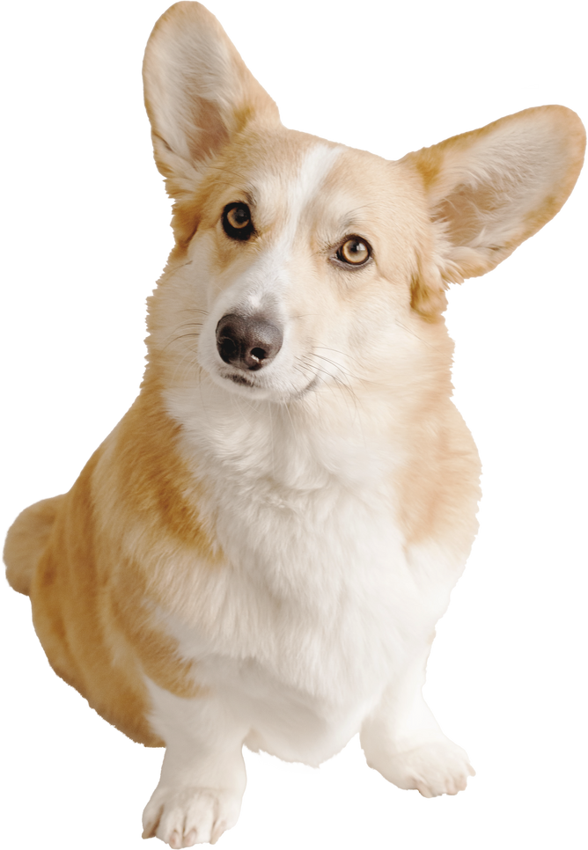
HIGH-LEVEL DESCRIPTION
We will be using:
heart rate sensor, temperature sensor, oxygen sensor
Pet wearable vest/collar
Basys hardware
Problems:
Durability
Pet Safety
Comfort

Slide 8

COMPETITIVE
ADVANTAGE
DogLeggs
PetPace
These products are specialized in design and the costs are relatively high for some consumers.

Slide 9
SOURCES
A. Johnson and B. Smith, "Real-time Monitoring of Pet Health with Wearable Devices," *Journal of Veterinary Medicine*, vol. 42, no. 3, pp. 345-358, 2020.
“How it works - PetPace,” Jul. 20, 2023. https://petpace.com/how-it-works/ (accessed Sep. 01, 2023).
E. K. Wilson et al., "Cost-Benefit Analysis of Pet Health Wearables for Preventive Care," Journal of Economic Perspectives, vol. 31, no. 3, pp. 189-204, 2017.
“Dog Leg Wraps, Braces, & Carpal Support | Hygroma Treatment Solutions,” www.dogleggs.com. https://www.dogleggs.com/ (accessed Sep. 01, 2023).
P. Harrop, E. Napier, R. Das, and N. Tsao, "Wearable technology for animals 2017–2027: technologies, markets, forecasts," IDTechEx Research, 2016.

